Slide 1
Sustainability Assurance: Iaasb update
Adj Prof Yvette Lange
#IRCConf24
2024

Slide 2
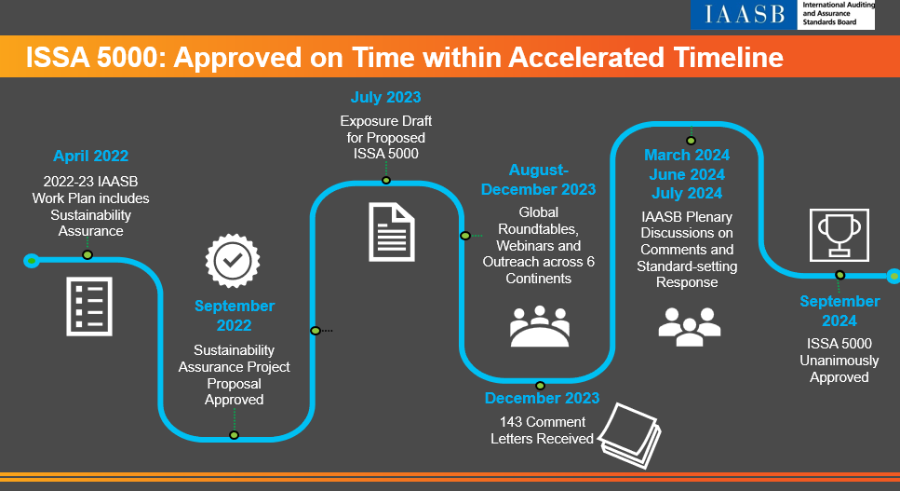
#IRCConf24
#integratedreporting
IRC Annual Conference 2024

Slide 3
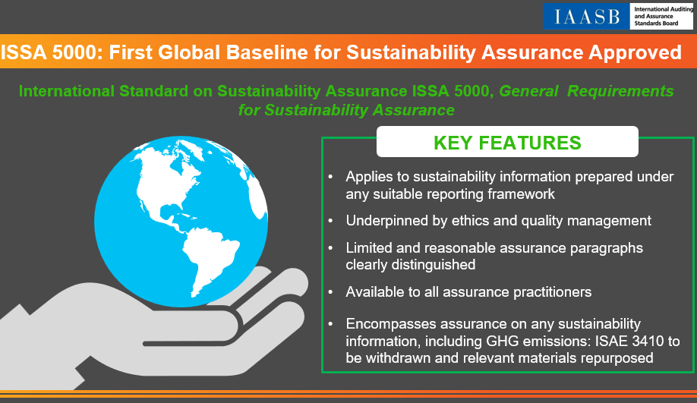
#IRCConf24
#integratedreporting
IRC Annual Conference 2024

Slide 4
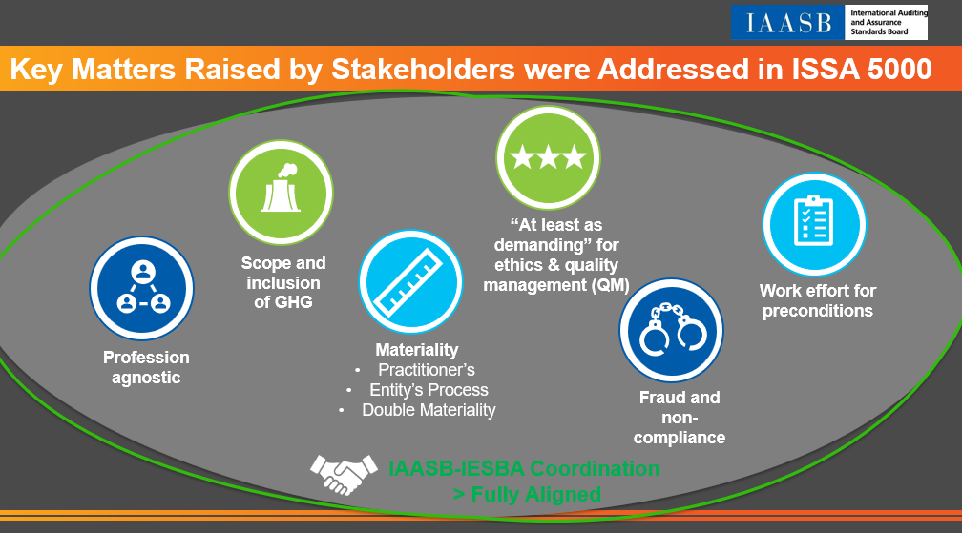
#IRCConf24
#integratedreporting
IRC Annual Conference 2024

Slide 5
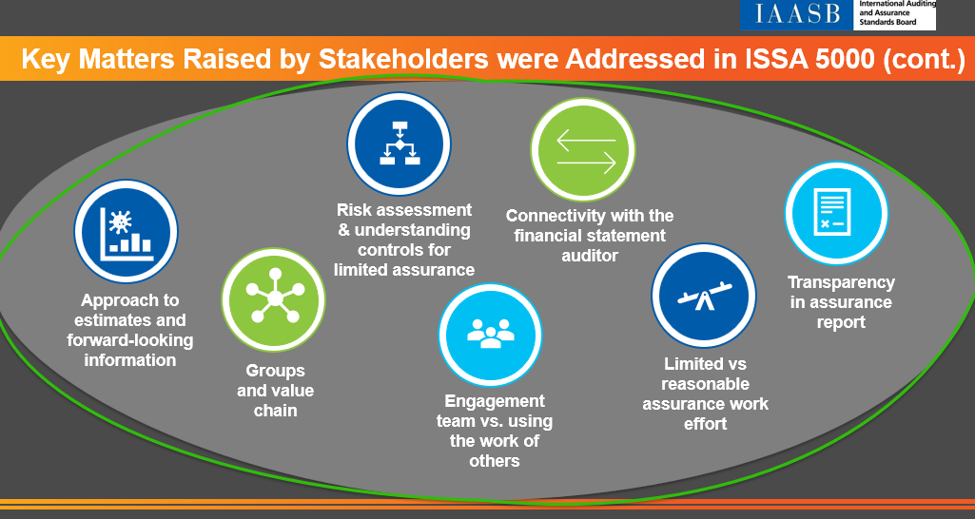
#IRCConf24
#integratedreporting
IRC Annual Conference 2024

Slide 6
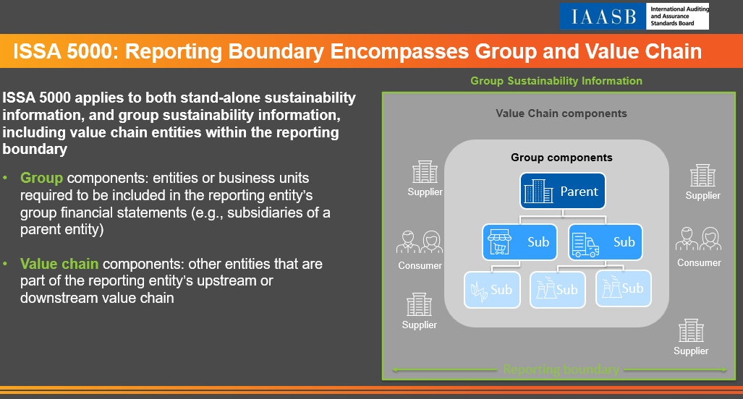
#IRCConf24
#integratedreporting
IRC Annual Conference 2024

Slide 7
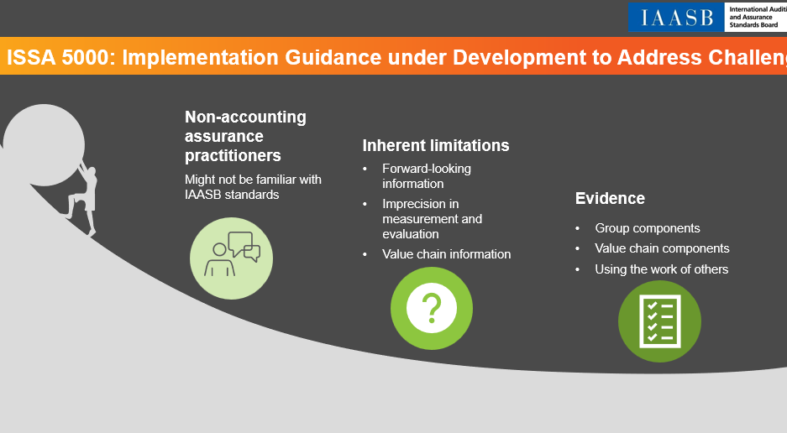
#IRCConf24
#integratedreporting
IRC Annual Conference 2024

Slide 8
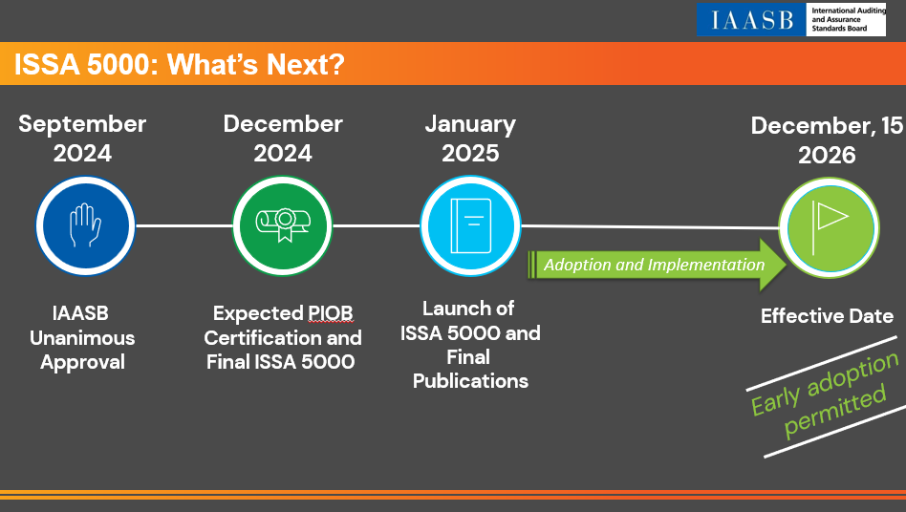
#IRCConf24
#integratedreporting
IRC Annual Conference 2024

Slide 9
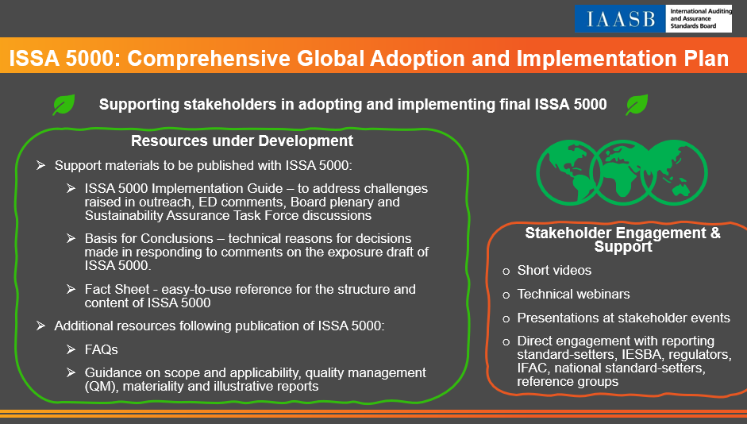
#IRCConf24
#integratedreporting
IRC Annual Conference 2024

